Slide 1
Model building & Evaluation
DO HOANG HUONG LIEN

Slide 2
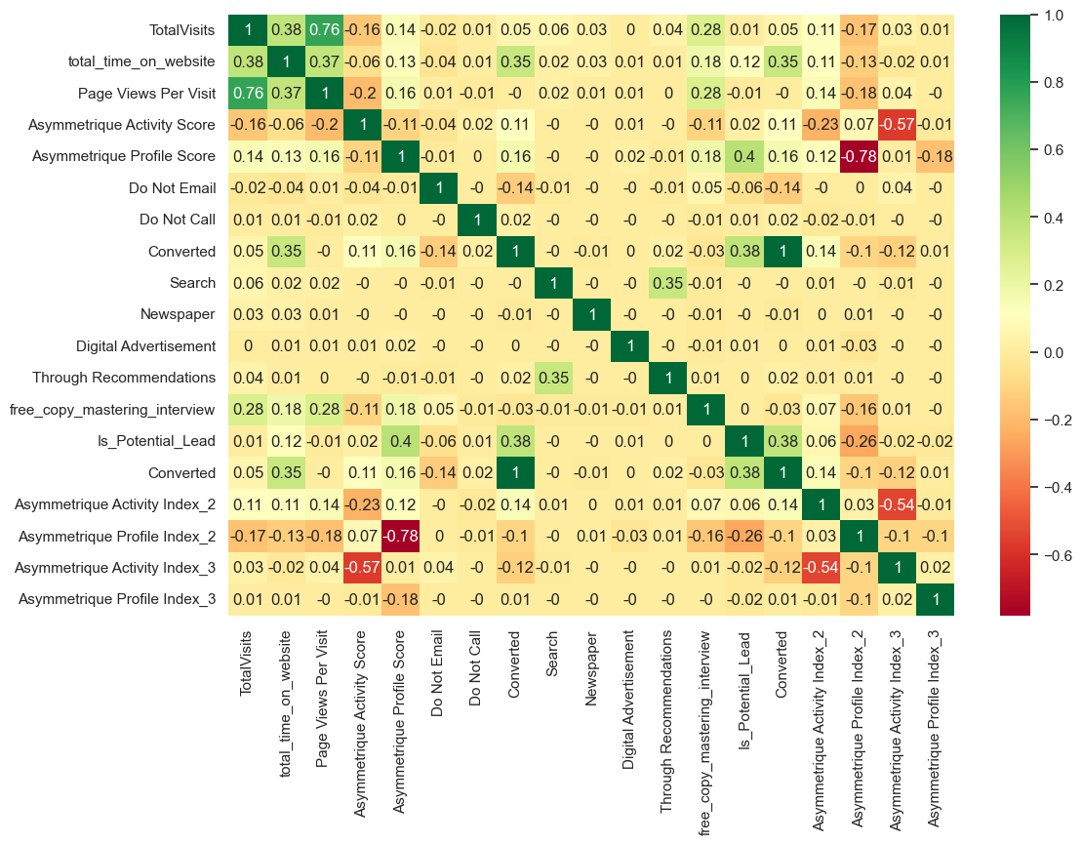
The displays a correlation heatmap of various metrics related to website visits, user interactions, and marketing activities. Here are some key observations:
High Positive Correlations:
`TotalVisits` and `total_time_on_website` have a strong positive correlation (0.38).
Page Views Per Visit shows a strong correlation with TotalVisits (0.76).
Negative Correlations:
Do Not Email appears to have negative correlations with several variables, notably with Converted (-0.38).
Test-train split and scaling

Slide 3
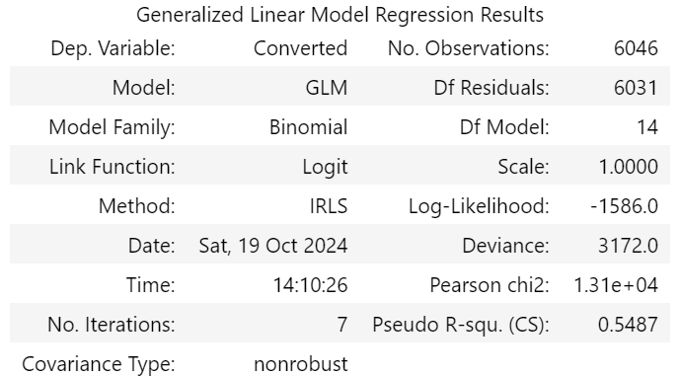
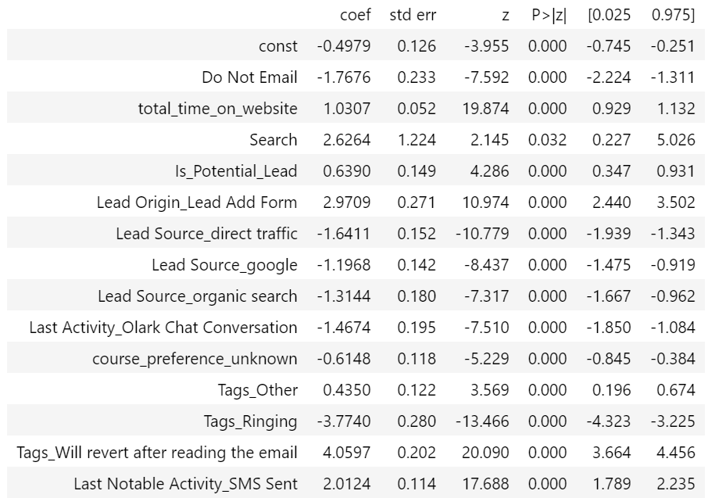

Slide 4
Model Information:
Family: Binomial, indicating logistic regression for binary outcomes.
Link Function: Logit, suitable for binary response variables.
Coefficients:
Do Not Email: Significant negative effect on conversion (coefficient: -0.4979, p < 0.05).
total_time_on_website: Positive and significant effect (coefficient: 0.5521, p < 0.05).
Lead Source_olark Chat: Positive and significant effect (coefficient: 1.2406, p < 0.05).
Model building

Slide 5
3. P-Values:
Indicates significance of coefficients. For instance, total_time_on_website and Lead Source_olark Chat have significant p-values, suggesting these factors significantly impact conversion rate.
4. Model Quality:
Pseudo R-squared (Cox & Snell): 0.5487, indicating a moderate level of explained variance by the model.
5. Interpretation:
Variables such as email preferences, time spent on the website, and certain lead sources play a significant role in conversion probabilities.

Slide 6
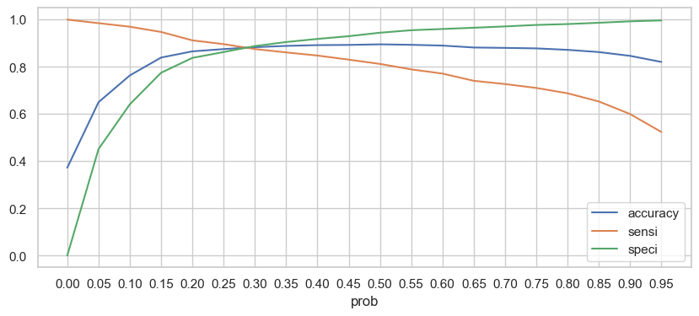
The the variation in model performance metrics—accuracy, sensitivity (sensi), and specificity (speci)—across different probability thresholds.
- Model variable: lrm2
- Cutoff point: 0.28
- Accuracy: 0.88
- Sensitivity: 0.88
Model evaluation

Slide 7
Accuracy: The blue line represents the overall accuracy of the model, showing how well the model predicts conversions at different probability thresholds. It peaks around the 0.3 threshold.
Sensitivity (Sensi): The orange line indicates sensitivity, or the true positive rate. It's highest at lower thresholds, meaning the model is better at identifying actual conversions when it allows more predictions to be positive.
Specificity (Speci): The green line shows specificity, or the true negative rate. It's highest at higher probability thresholds, indicating that the model is better at correctly identifying non-conversions when it requires stronger evidence to predict conversion.
Optimal Threshold: The intersection points and relative heights can help determine an optimal threshold where the model maintains a balance between sensitivity and specificity, often aligned with high accuracy.

Slide 8
So we end up with a model with 0.88 accuracy & sensitivity & specificity on the train test, and 0.87 accuracy & sensitivity on the test set.
A drop of only 0.01 indicate a reliable model had been build!
Evaluation test-set

